Slide 1
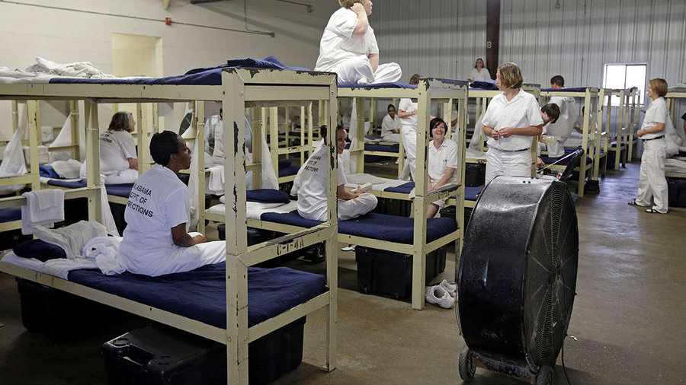
First Step Act of 2018:
Mass Incarceration
Erik R. Lopez | April 05, 2025 | erlopez95@gmail.com
This Photo by Unknown Author is licensed under CC BY

Slide 2

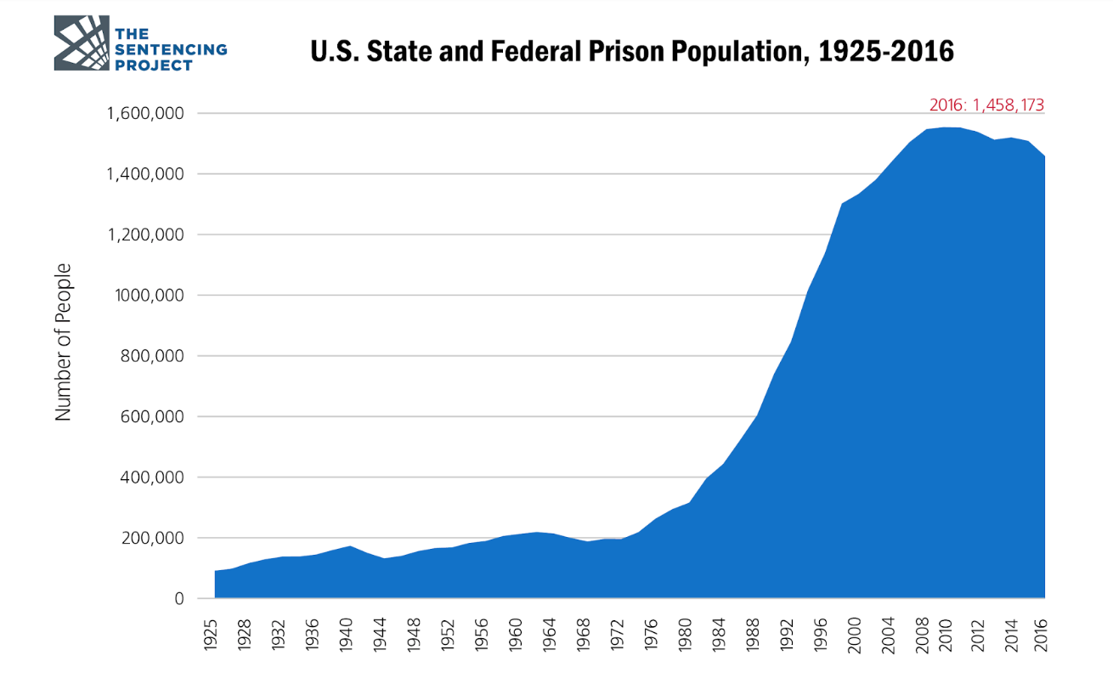
The Problem: Mass Incarceration
Mass incarceration has led to severe prison overcrowding.
Existing policies are insufficient to address the problem.
High recidivism rate (52& within 3 years).
Significant financial burden ($80 billion annually).
This Photo by Unknown Author is licensed under CC BY-SA

Slide 3
GCT: Sentence reductions for positive inmate behavior.
Current Limit: 15% reduction (First Step Act of 2018)
Eligibility: Low risk, non-violent, first-time offender.
Incentive for rehabilitation and positive behavior.
Good Conduct Time (GCT) Overview

Slide 4
Policy Recommendation #1:
Increase GCT Reduction
Increase GCT reduction to 30%
Benefits: Reduce overcrowding, incentivize positive behavior.
Potential addition: Prison work behavior.

Slide 5
Policy Recommendation #2:
Enhance Credit Transparency
Implement a transparent GCT credit calculation system.
Provide inmates with regular updates on earned time.
Increases inmates' motivation.
Reinforced positive behavior.

Slide 6
Policy Recommendation #3:
Expand GCT Eligibility
Revise eligibility criteria using risk assessments.
Include more non-violent offenders.
Benefits: reduces prison population, expands rehabilitation access.

Slide 7
Alternative Policy #1:
Enhanced Rehabilitation
Increase funding and access to program effectiveness.
Conduct longitudinal research on program effectiveness.
Goal: Reduce recidivism.

Slide 8
Alternative Policy #2:
Reclassify Inmate Fighting
Reclassify fighting as a minor infraction.
Allows for discretionary judgment in self-defense cases.
Protects inmates from disproportionate punishment.

Slide 9

Conclusion: Path to Reform
Reform is essential to reduce mass incarceration.
Proposed policies will promote a more just and effective system.
Goal: Equitable and safe society.

Slide 10
References
Addison, H. A., Richmond, T. S., Lewis, L. M., & Jacoby, S. (2022). Mental health outcomes in formerly incarcerated black men: A systematic mixed studies review. Journal of Advanced Nursing. https://doi.org/10.1111/jan.15235
Anderson-Facile, D. (2009). Basic challenges to prisoner reentry. Sociology Compass. https://doi.org/10.1111/j.1751-9020.2009.00198.x
Bureau of Prisons. (2022). Good conduct time credit under the First Step Act. Federal Register. https://www.federalregister.gov/documents/2022/02/11/2022-02876/good-conduct-time-credit-under-the-first-step-act
Federal Bureau of Prisons. (n.d.). Disqualifying offenses. Federal Bureau of Prisons. https://www.bop.gov/resources/fsa/time_credits_disqualifying_offenses.jsp
Gau, J. M. (2019). Criminal justice policy: Origins and effectiveness. New York, NY: Oxford University Press.
James, N. (2019). The FIRST STEP ACT OF 2018: An overview. Congressional Research Service Journal.
Pękala-Wojciechowska, A., Kacprzak, A., Pękala, K., Chomczyńska, M., Chomczyński, P., Marczak, M., Kozłowski, R., Timler, D., Lipert, A., Ogonowska, A., & Rasmus, P. (2021). Mental and physical health problems as conditions of ex-prisoner re-entry. International Journal of Environmental Research and Public Health. https://doi.org/10.3390/ijerph18147642
Sandin v. Conner, 515 U.S. 472 (1995). https://supreme.justia.com/cases/federal/us/515/472/
Wolf v. McDonnell, 418 U.S. 539 (1974). https://supreme.justia.com/cases/federal/us/418/539/

Slide 11
Any Questions?!

